Slide 1
DATABASE Management SYSYEMs
Introduction to

Slide 2
Evaluation Criteria
Mid Sem- 20%
End Sem-40%
Scheduled Quiz- 10%
Lab Assessment -10%
Lab Exam- 20%

Slide 3
Database Systems
DBMS contains information about a particular enterprise
Collection of interrelated data
Set of programs to access the data
An environment that is both convenient and efficient to use
Database systems are used to manage collections of data that are:
Highly valuable
Relatively large
Accessed by multiple users and applications, often at the same time.
A modern database system is a complex software system whose task is to manage a large, complex collection of data.
Databases touch all aspects of our lives
Notes:
3

Slide 4
Syllabus
Unit – 1 [4 Hours]: Database System Concepts - Data Models, Schemas, Instances
Unit – 2 [8 Hours]: Database system architecture - Three-Level Architecture and Data Independence, Database Languages and Interfaces, Centralized and Client/Server Architectures for DBMS
Unit – 3 [8 Hours]: Data Modeling - Entity-Relationship Diagram, Relational Model, Integrity constraints and data manipulation operations, Relational Algebra and Relational Calculus
Unit – 4 [10 Hours]: SQL (Structured Query Language) - Data Definition and Data Types, Constraints, Queries, Insert, Delete, and Update Statements, Views, Stored Procedures and Functions, Database Triggers, SQL Injection
Unit – 5 [10 Hours]: Normalization for Relational Databases - Functional Dependencies, Normalization; Query Processing, Query Optimization algorithms.
Unit – 6 [8 Hours]: Transaction Processing - Transaction Processing, Concurrency Control Techniques; Database Recovery Techniques; Object and Object-Relational Databases; Database Security and Authorization.

Slide 5
Database Applications Examples
Enterprise Information
Sales: customers, products, purchases
Accounting: payments, receipts, assets
Human Resources: Information about employees, salaries, payroll taxes.
Manufacturing: management of production, inventory, orders, supply chain.
Banking and finance
customer information, accounts, loans, and banking transactions.
Credit card transactions
Finance: sales and purchases of financial instruments (e.g., stocks and bonds; storing real-time market data
Universities: registration, grades
Notes:
5

Slide 6
Database Applications Examples (Cont.)
Airlines: reservations, schedules
Telecommunication: records of calls, texts, and data usage, generating monthly bills, maintaining balances on prepaid calling cards
Web-based services
Online retailers: order tracking, customized recommendations
Online advertisements
Document databases
Navigation systems: For maintaining the locations of varies places of interest along with the exact routes of roads, train systems, buses, etc.
Notes:
6

Slide 7
Purpose of Database Systems
In the early days, database applications were built directly on top of file systems, which leads to:
Data redundancy and inconsistency: data is stored in multiple file formats resulting induplication of information in different files
Difficulty in accessing data
Need to write a new program to carry out each new task
Data isolation
Multiple files and formats
Integrity problems
Integrity constraints (e.g., account balance > 0) become “buried” in program code rather than being stated explicitly
Hard to add new constraints or change existing ones
Notes:
7

Slide 8
Purpose of Database Systems (Cont.)
Atomicity of updates
Failures may leave database in an inconsistent state with partial updates carried out
Example: Transfer of funds from one account to another should either complete or not happen at all
Concurrent access by multiple users
Concurrent access needed for performance
Uncontrolled concurrent accesses can lead to inconsistencies
Ex: Two people reading a balance (say 100) and updating it by withdrawing money (say 50 each) at the same time
Security problems
Hard to provide user access to some, but not all, data
Database systems offer solutions to all the above problems
Notes:
8

Slide 9
University Database Example
In this text we will be using a university database to illustrate all the concepts
Data consists of information about:
Students
Instructors
Classes
Application program examples:
Add new students, instructors, and courses
Register students for courses, and generate class rosters
Assign grades to students, compute grade point averages (GPA) and generate transcripts
Notes:
9

Slide 10
View of Data
A database system is a collection of interrelated data and a set of programs that allow users to access and modify these data.
A major purpose of a database system is to provide users with an abstract view of the data.
Data models
A collection of conceptual tools for describing data, data relationships, data semantics, and consistency constraints.
Data abstraction
Hide the complexity of data structures to represent data in the database from users through several levels of data abstraction.
Notes:
10

Slide 11
Data Models
A collection of tools for describing
Data
Data relationships
Data semantics
Data constraints
Relational model
Entity-Relationship data model (mainly for database design)
Object-based data models (Object-oriented and Object-relational)
Semi-structured data model (XML)
Other older models:
Network model
Hierarchical model
Notes:
11

Slide 12
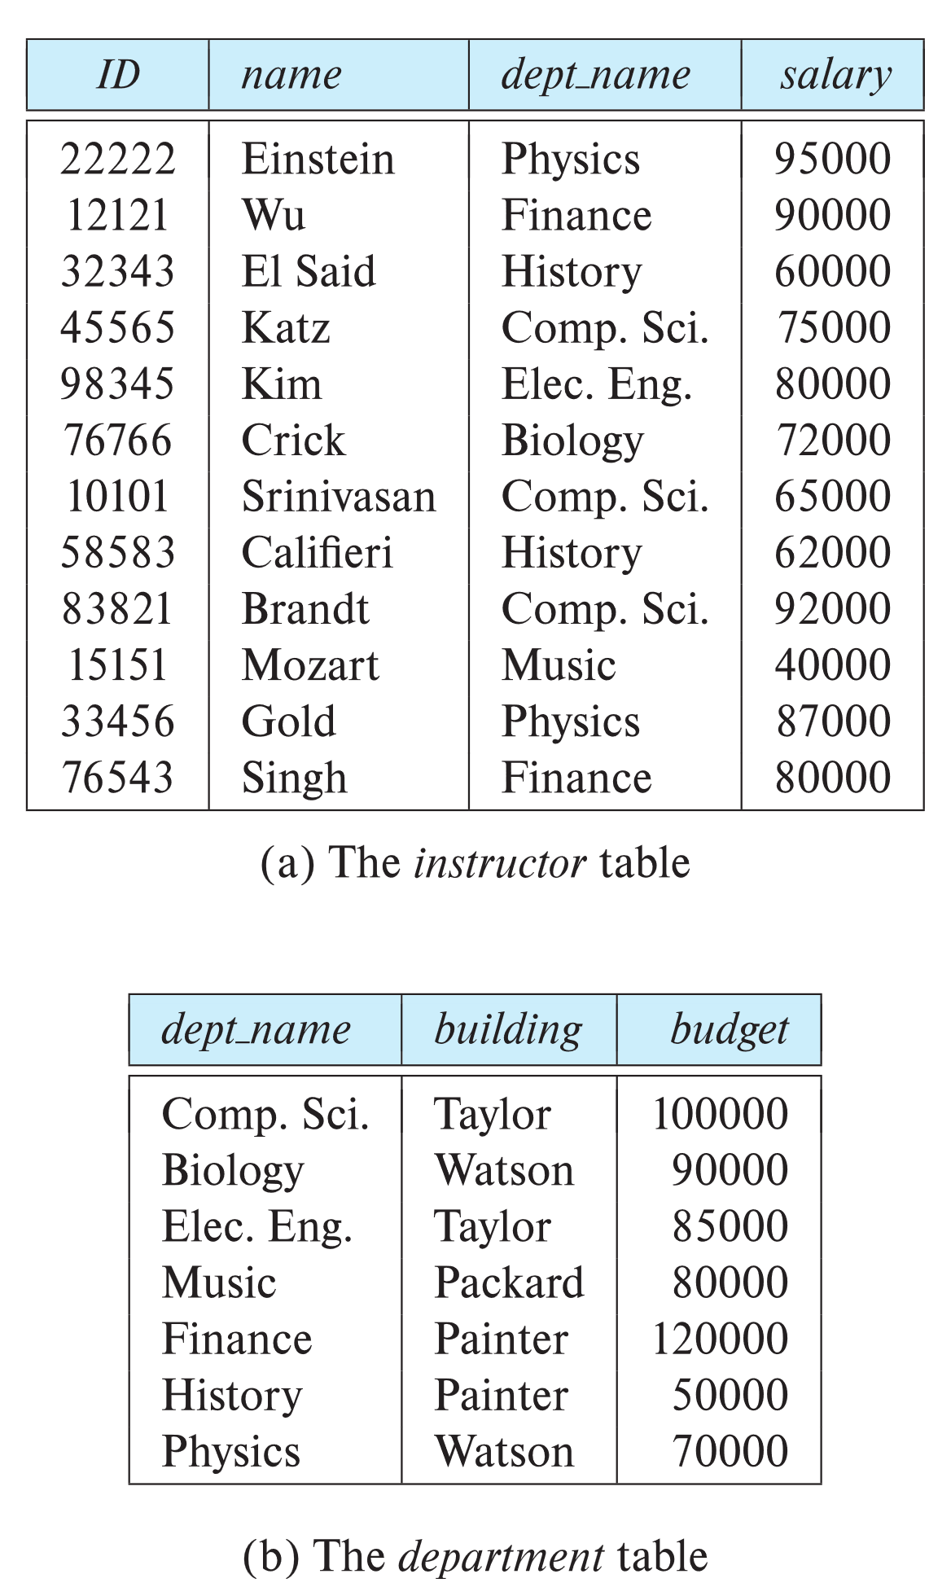

Relational Model
All the data is stored in various tables.
Example of tabular data in the relational model
Columns
Rows
Ted Codd Turing Award 1981
Notes:
12

Slide 13
A Sample Relational Database
Notes:
13

Slide 14
Levels of Abstraction
Physical level: describes how a record (e.g., instructor) is stored.
Logical level: describes data stored in database, and the relationships among the data.
type instructor = record
ID : string; name : string; dept_name : string; salary : integer;
end;
View level: application programs hide details of data types. Views can also hide information (such as an employee’s salary) for security purposes.
Notes:
14

Slide 15
View of Data
An architecture for a database system
Notes:
15

Slide 16
Instances and Schemas
Similar to types and variables in programming languages
Logical Schema – the overall logical structure of the database
Example: The database consists of information about a set of customers and accounts in a bank and the relationship between them
Analogous to type information of a variable in a program
Physical schema – the overall physical structure of the database
Instance – the actual content of the database at a particular point in time
Analogous to the value of a variable
Notes:
16

Slide 17
Physical Data Independence
Physical Data Independence – the ability to modify the physical schema without changing the logical schema
Applications depend on the logical schema
In general, the interfaces between the various levels and components should be well defined so that changes in some parts do not seriously influence others.
Notes:
17

